Slide 1


Noida Institute of Engineering and Technology, Greater Noida
Rural Planning & Development
Unit: 1
Rural Development: Administration and Planning
Simran Kaur
MBA
Department
BTECH 4TH Year (7TH Sem)

Slide 2

Contents
S. No. | Index
1. | Name of Subject with code, Course and Subject Teacher
2. | Brief Introduction of Faculty member with Photograph
3. | Evaluation Scheme
4. | Syllabus
5. | Branch wise Application
6. | Course Objective(s)
7. | Course Outcome(s)
8. | Program Outcomes (POs)
9. | COs and POs Mapping

Slide 3
Contents
S. No. | Index
10. | Program Specific Outcomes (PSOs)
11. | Cos and PSOs Mapping
12. | Program Educational Objectives (PEOs)
13. | Result Analysis
14. | End Semester Question paper Templates
15. | Prequisite/Recap
16. | Brief Indtroduction about the Subject with Videos
17. | Unit Contents
18. | Unit Objectives
19. | Topic Objectives/Topic Outcome

Slide 4
Contents
S. No. | Index
20. | Lecture related to topic
21. | Daily Quiz
22. | Weekly Assignment
23. | Topic Links
24. | MCQs
25. | Glossary Questions
26. | Old question papers
27. | Expected Questions
28. | Recap of unit

Slide 5
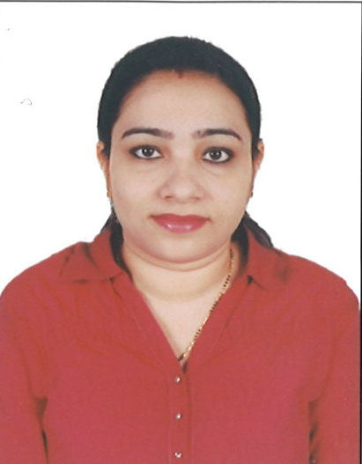
Faculty Profile
Faculty Name: Ms. Simran Kaur
Designation: Assistant Professor
Department: MBA
Email ID: simrankaur.mba@niet.co.in
Qualification: UGC NET, JRF, MBA, PGDM, Pursuing Ph.D
Specialisation: HR & Marketing
Research Area: OB
Total Experience:7+ years

Slide 6
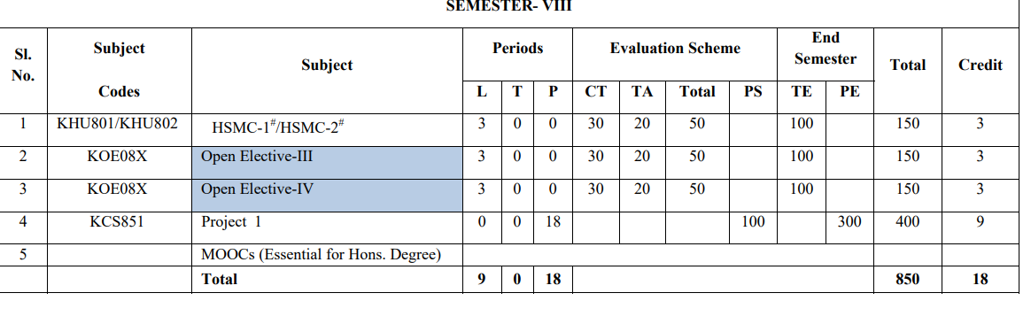
Evaluation Scheme

Slide 7
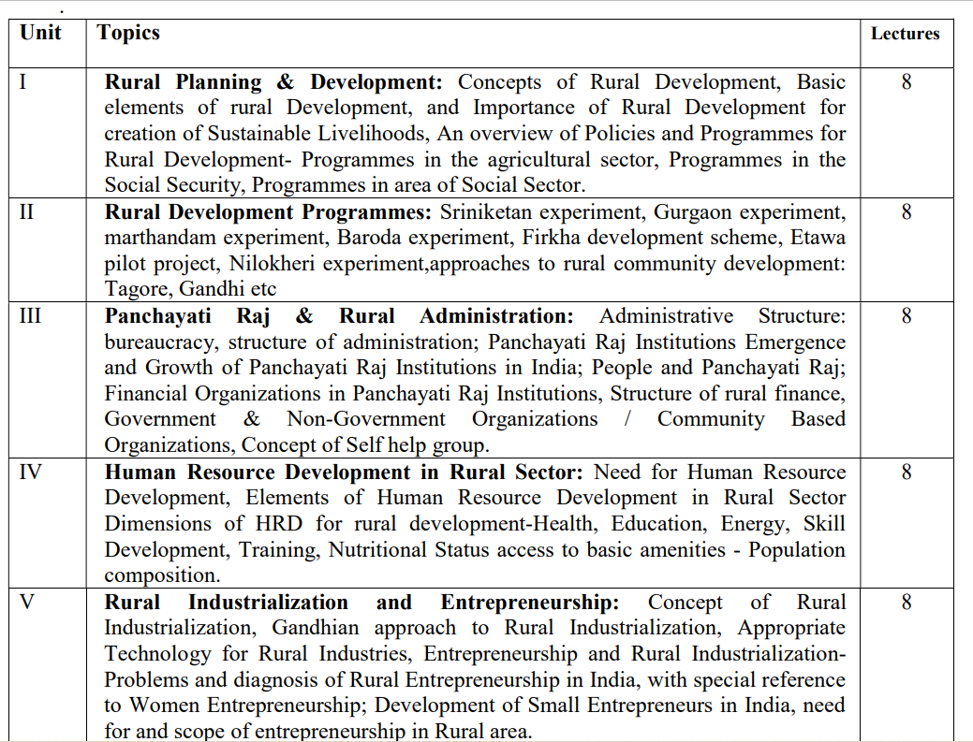
Syllabus
Syllabus

Slide 8
Applications of this course in B.Tech
Rural development course offers an understanding of how strategies for the management of rural areas and their implementation are planned and executed.
There are further courses at graduate and post graduate levels for people who are interested in working in rural development co-operatives and development organizations.
The emergence of capitalism in rural areas can be understood as Rural Development.
It basically refers to the modernization and development of rural cities and areas.
It is also concerned with the socio-economic development of rural people.
Hence, those who aspire to pursue a rural development course will get to learn the same during the years of their study.

Slide 9
Course Objectives
To Understand the definitions, concepts and components of Rural Development
To Know the importance, structure, significance, resources of Indian rural economy
To help them in developing the ability to have a clear idea about the area development programmes and its impact.
To be able to acquire knowledge about rural entrepreneurship
To develop the understanding about the using of different methods for human resource planning

Slide 10
Course Outcomes
CO1: Understand the definitions, concepts and components of Rural Development | Understand ( K 2)
CO2: Know the importance, structure, significance, resources of Indian rural economy. | Apply ( K 3)
CO3: Develop the ability to have a clear idea about the area development programmes and its impact. | Analyzing ( K 4)
CO4: Able to acquire knowledge about rural entrepreneurship. | Applying ( K 3)
CO5: Understand about the using of different methods for human resource planning | Understand ( K 2)

Slide 11
Program Outcomes
1. Engineering knowledge: Apply the knowledge of mathematics, science, engineering fundamentals, and an engineering specialization to the solution of complex engineering problems.
2. Problem analysis: Identify, formulate, review research literature, and analyze complex engineering problems reaching substantiated conclusions using first principles of mathematics, natural sciences, and engineering sciences.
3. Design/development of solutions: Design solutions for complex engineering problems and design system components or processes that meet the specified needs with appropriate consideration for the public health and safety, and the cultural, societal, and environmental considerations.
4. Conduct investigations of complex problems: Use research-based knowledge and research methods including design of experiments, analysis and interpretation of data, and synthesis of the information to provide valid conclusions.

Slide 12
Program Outcomes
5. Modern tool usage: Create, select, and apply appropriate techniques, resources, and modern engineering and IT tools including prediction and modeling to complex engineering activities with an understanding of the limitations.
6. The engineer and society: Apply reasoning informed by the contextual knowledge to assess societal, health, safety, legal and cultural issues and the consequent responsibilities relevant to the professional engineering practice.
7. Environment and sustainability: Understand the impact of the professional engineering solutions in societal and environmental contexts, and demonstrate the knowledge of, and need for sustainable development.
8. Ethics: Apply ethical principles and commit to professional ethics and responsibilities and norms of the engineering practice.

Slide 13
Program Outcomes
9. Individual and team work: Function effectively as an individual, and as a member or leader in diverse teams, and in multidisciplinary settings.
10. Communication: Communicate effectively on complex engineering activities with the engineering community and with society at large, such as, being able to comprehend and write effective reports and design documentation, make effective presentations, and give and receive clear instructions.
11. Project management and finance: Demonstrate knowledge and understanding of the engineering and management principles and apply these to one’s own work, as a member and leader in a team, to manage projects and in multidisciplinary environments.
12. Life-long learning: Recognize the need for, and have the preparation and ability to engage in independent and life-long learning in the broadest context of technological change.

Slide 14
CO-PO Mapping
PO CO | PO 1 | PO 2 | PO 3 | PO 4 | PO 5 | PO 6 | PO 7 | PO 8 | PO 9 | PO 10 | PO 11 | PO 12
CO 1 | 2 |  |  | 2 |  |  |  |  |  |  |  | 2
CO 2 |  |  |  |  |  |  | 3 | 2 |  |  |  | 3
CO 3 |  | 2 |  |  |  |  |  | 3 |  |  |  | 2
CO 4 |  |  |  |  |  |  |  |  | 2 |  |  | 3
CO 5 |  |  |  |  |  |  | 2
Avg. | 0.4 | 0.4 |  | 0.4 |  |  | 1 | 1 | 0.4 |  |  | 2

Slide 15

Program Specific Outcomes
S.NO. | Program Specific Outcomes | PSO Description
1 | PSO1 | Ability to design manufacturing processes, products, the equipment, tooling and necessary environment for the manufacture of products that meet specific material and other requirements.
2 | PSO2 | Ability to use design, manufacturing and industrial engineering software packages to formulate and solve real time issues.
3 | PSO3 | Ability to analyze, synthesis and control manufacturing operations using statistical methods and to create competitive advantage through the application of manufacturing planning, strategy, quality and control concepts.

Slide 16
Program Educational Objectives
PEO1: Able to apply sound knowledge in the field of information technology to fulfill the needs of IT industry.
PEO2: Able to design innovative and interdisciplinary systems through latest digital technologies.
PEO3: Able to inculcate professional and social ethics, team work and leadership for serving the society.
PEO4: Able to inculcate lifelong learning in the field of computing for successful career in organizations and R&D sectors.

Slide 17
Result analysis
Result Awaited
Simran Kaur KHU701_RD Unit 1

Slide 18
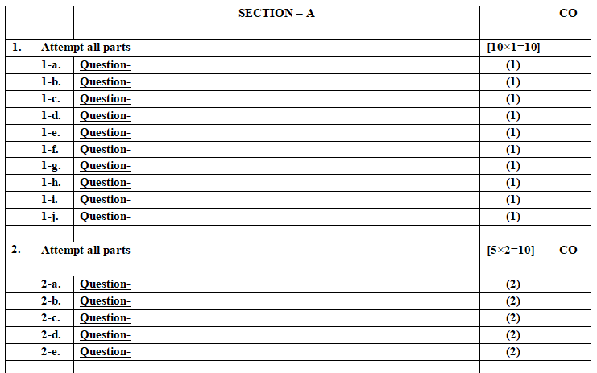
End Semester Question Paper Template
Simran Kaur KHU701_RD Unit 1

Slide 19
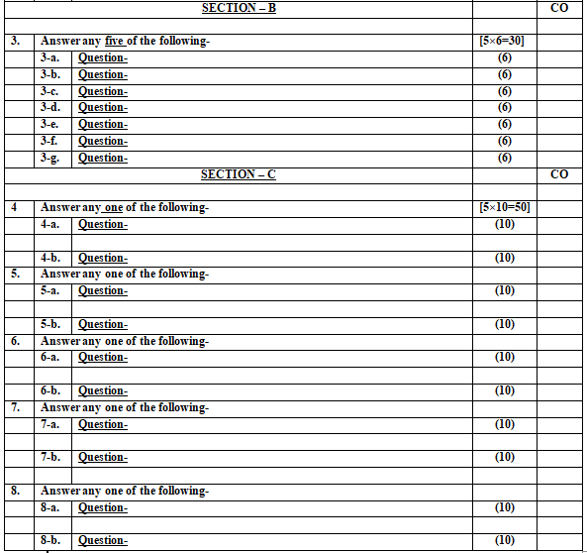
End Semester Question Paper Template
Simran Kaur KHU701_RD Unit 1

Slide 20
Prerequisites / Recap
Students should have a basic understanding of the:
Rural and Urban sector
Agriculture
Planning and Development
Simran Kaur KHU701_RD Unit 1

Slide 21
Brief Introduction about the Subject with videos
Rural development is the process of improving the quality of life and economic well-being of people living in rural areas.
The objective of this course is to introduce, discuss and frame aspects of rural development and to relate these to rural livelihoods, socio-economic inequalities and the local institutional embeddedness of financial services’ providers.
We start with presenting rural development in the theoretical debate on economic development. Then we discuss issues of rural livelihoods with regards to local socio-economic inequalities.
https://www.youtube.com/watch?v=7BIz-jX46GY&list=PL8kNpySS1WHp6UPvnTb6rFOI9h4il6Hbd
Simran Kaur KHU701_RD Unit 1

Slide 22
Unit Contents
Concepts and basic elements of Rural Development
Importance of Rural Development for creation of Sustainable Livelihoods
An overview of Policies and Programmes for Rural Development: Programmes in the agricultural sector
Programmes in the Social Sector: Social Security

Slide 23
Unit Objectives
To make the students understand the concept of Rural development
To explain the Policies and Programmes for Rural Development
To discuss Importance of Rural Development for creation of Sustainable Livelihoods

Slide 24

Noida Institute of Engineering and Technology, Greater Noida
(Unit –I) Topic 1
Concepts of Rural Development

Slide 25
Session Objectives
Topic | Course Outcome
Understand the meaning of Rural development. Identify the concepts and importance of Rural development. | CO1

Slide 26
Defining 'rural'
Rural - Is an area, where the people are engaged in primary industry in the sense that they produce things directly for the first time in cooperation with nature as stated by Srivastava (1961).
A society or community can be classified as rural based on the criteria of lower population density, less social differentiation, less social and spatial mobility, slow rate of social change, etc. Agriculture would be the major occupation of rural area.

Slide 27
Defining 'development’
Development: It refers to growth, evolution, stage of inducement or progress. This progress or growth is gradual and had sequential phases. Always there is increasing differentiation. It also refers to the over all movement towards greater efficiency and complex situations.

Slide 28
Concept of Rural development
Rural Development (RD): is a process which aims at improving the well being and self realisation of people living outside the urbanized areas through collective process.
According to Agarwal (1989) rural development is a strategy designed to improve the economic and social life of rural poor.

Slide 29
Introduction Of Rural Development
Rural Development is the process of improving the quality of life and economic well-being of people living in rural areas, often relatively isolated and sparsely populated areas. Rural Development has traditionally centered on the exploitation of land-intensive natural resources such as agriculture and forestry.
Rural development is a term that concentrates on the actions taken for the development of rural areas to improve the economy.

Slide 30
Introduction Of Rural Development
However, few areas that demand more focused attention and new initiatives are:
Education
Public health and Sanitation
Women empowerment
Infrastructure development (electricity, irrigation, etc.)
Facilities for agriculture extension and research
Availability of credit
Employment opportunities

Slide 31
Introduction Of Rural Development
It relates primarily to areas that have a relatively low population density compared to cities, areas where agriculture and related activities usually dominate the landscape and economy, and places where transport and communications need to cover relatively large distances making travel and service provision relatively difficult and costly.
However, our definition also includes the towns (as opposed to cities) that are located in these areas and which are linked to them culturally and economically by acting as a focal point for people living in the surrounding areas - places where they can meet, exchange goods and services, and find transport to larger urban centres.

Slide 32
Basic objectives of Rural development
The major objectives of rural development are:
to achieve enhanced production and productivity in rural areas,
to bring about a greater socio-economic equity,
to bring about a spatial balance in social and economic development,
to bring about improvement in the ecological environment so that it may be conducive to growth and happiness, and
to develop broad based community participation in the process of development.
Simran Kaur KHU701_RD Unit 1

Slide 33
Importance of Rural development
Rural development is a dynamic process which is mainly concerned with the rural areas. These include agricultural growth, putting up of economic and social infrastructure, fair wages as also housing and house sites for the landless, village planning, public health, education and functional literacy, communication etc.
Notes:
https://www.youtube.com/watch?v=DcY0KEdBA2A&t=1s

Slide 34
Importance of Rural development
Rural development is a national necessity and has considerable importance in India because of the following reasons.
about three-fourth of India's population live in rural areas,
nearly half of the country's national income is derived from agriculture,
around seventy per cent of Indian population get employment through agriculture,
bulk of raw materials for industries come from agriculture and rural sector,
increase in industrial population can be justified only in rural populations' motivation and increasing the purchasing power to buy industrial goods, and
growing disparity between the urban elite and the rural poor can lead to political instability
Notes:
https://www.youtube.com/watch?v=DcY0KEdBA2A&t=1s

Slide 35
Daily Quiz
1. Which of the following can help in the development of human resources?
a. Improving literacy skills
b. Skill development
c. Training
d. All of the above
2. Rural development aims at ________ .
a. Improving health facilities
b. Reducing poverty
c. Developing infrastructure
d. All of the above
3. _________ is the process of improving the quality of life and economic well-being of people living in rural areas.
4. Development refers to growth, evolution, stage of inducement or progress. (True/ False)
Simran Kaur KHU701_RD Unit 1
Notes:
https://www.youtube.com/watch?v=DcY0KEdBA2A

Slide 36
Noida Institute of Engineering and Technology, Greater Noida
(Unit –I) Topic 2
Rural Development for creation of Sustainable Livelihoods

Slide 37
Recap
We have discussed about:
Concept of Rural, Development and Rural developmemt
Objectives of Rural development
Importance of Rural development
Notes:
https://www.youtube.com/watch?v=DcY0KEdBA2A

Slide 38
Session Objectives
Topic | Course Outcome
To understand the importance of Rural Development for creation of Sustainable Livelihoods | CO1
38

Slide 39
Concept of sustainable livelihood
Livelihood. A livelihood comprises the capabilities, assets and activities required for a means of living (Chambers & Conway 1988).
Sustainable livelihood. A livelihood is sustainable when it can cope with and recover from the stresses and shocks and maintain or enhance its capabilities and assets both now and in the future without undermining the natural resource base (Chambers & Conway).
Household livelihood security. Household livelihood security is defined as adequate and sustainable access to income and resources to meet basic needs

Slide 40
Importance Of Rural Development for creation of sustainable livelihood
It is estimated that in 2005 there were 2.6 billion people living in poverty, that is, on less than US$2 per day, and about 1.4 billion people living in extreme poverty, that is on less than one US$1.25 per day (World Bank 2011).
Estimates of the proportion of the world’s poor that live in rural areas vary but for 2005 this was estimated at 70% (with just 55% of the world’s total population living in rural areas) (IFAD 2010).

Slide 41
Importance Of Rural Development for creation of sustainable livelihood
It is further predicted that, despite urban migration, a little over one-third of the world’s population will live in rural areas by 2030, just under two-thirds of the world’s poor people will still be rural by 2030, and both poverty incidence and depth of poverty will continue to be greater in rural areas (World Bank 2007).
Such global figures hide large regional and national variations but nevertheless emphasize the magnitude of global poverty, and rural poverty in particular.

Slide 42
Principles of sustainable livelihood approaches
A sustainable livelihood approach (SLA) attempts to take a holistic perspective in determining problems and opportunities for programme activities. This holistic perspective involves taking into account:
Context. What are the social, economic, political, historical, demographic trends that influence the livelihood options of a given population and what are the risks to which they are exposed?

Slide 43
Principles of sustainable livelihood approaches
Resources. What are the various assets (financial, physical, social, human and natural) that households and communities have access to and how are they differentiated? Vulnerability is determined by the risks that households and communities are exposed to and their ability to use assets to cope with these risks.

Slide 44
Principles of sustainable livelihood approaches
Institutions and organizations. The institutions that operate within a given context will be critical to sustainable livelihood outcomes. It is important to identify which government, civic and private-sector institutions operate in a given livelihood setting to determine their relative strengths and weaknesses in delivering goods and services essential to secure livelihoods.

Slide 45
Principles of sustainable livelihood approaches
Livelihood strategies. A holistic diagnosis attempts to identify the various strategies people use to make a living and how they cope with stress. These are also referred to as adaptive and coping strategies in the food security literature.
Livelihood outcomes. Outcomes are measured to determine how successful households are in their livelihood strategies. These outcomes can be based on normative standards (e.g. nutritional status) or on criteria identified by the communities. Such outcome measures need to be differentiated across groups, households and individuals.

Slide 46
Principles of sustainable livelihood approaches
Application of participatory, people-centred approaches: SLA uses a wide variety of participatory tools for diagnosis, programme design and monitoring and evaluation. Participation and empowerment are the basic tenets of the approach.
Focused strategy: Although the SLA emphasizes holistic diagnosis, this does not mean that interventions must be multisectoral. Single-sector projects/programmes may be the most appropriate avenue to pursue based on a good problem and opportunity analysis.

Slide 47
Principles of sustainable livelihood approaches
Coherent information systems: The indicators used for monitoring and evaluation are clearly linked to the problem analysis and the objectives. Cross-sectoral impacts that are measured are derived from the links that are demonstrated from the holistic analysis. The project should not collect unnecessary data that is not clearly linked to the objective or the problem analysis.
Reflective practice: Programme information systems should be set up to capture both the intended and unintended consequences of programme activities.

Slide 48
Daily Quiz
1. A ________ comprises the capabilities, assets and activities required for a means of living.
2. A livelihood is _________ when it can cope with and recover from the stresses and shocks and maintain or enhance its capabilities and assets.
3. Household livelihood security is defined as adequate and sustainable access to income and resources to meet basic needs. (True/False)
4. Name any 2 financial institutions that enable people ensure sustainable livelihood.
Simran Kaur KHU701_RD Unit 1
Notes:
https://www.youtube.com/watch?v=DcY0KEdBA2A

Slide 49
Noida Institute of Engineering and Technology, Greater Noida
(Unit –I) Topic 3
Policies and Programmes for Rural Development- Agricultural sector

Slide 50
Recap
A livelihood is sustainable when it can cope with and recover from the stresses and shocks and maintain or enhance its capabilities and assets both now and in the future without undermining the natural resource base.
Simran Kaur KHU701_RD Unit 1
Notes:
https://www.youtube.com/watch?v=DcY0KEdBA2A

Slide 51
Session Objectives
Topic | Course Outcome
To understand the of Policies and Programmes for Rural Development- Programmes in the agricultural sector | CO1
51

Slide 52
Programmes and Policies for Agricultural and Rural Development
To motivate the farmers for more food grain production, union government has launched policy of Minimum Support Price (MSP) since 1966-67. This policy ensures minimum price to farmers for each crop.
On the other hand, Government launched the Mahatma Gandhi Rural Employment Guarantee Act (MGNREGA), Public Distribution System (PDS) for rural poor.
The macro management of agriculture (MMA) was revised in 2008 to improve the efficiency in supplementing the efforts of states to enhance agriculture production and productivity.

Slide 53
Programmes and Policies for Agricultural and Rural Development
Important policy measures introduced in the rural sector in India during the period of planning are as follows:
Technological Measures:To sustain and extend this programme to larger and larger areas of the country, steps were taken to increase the production of high-yielding varieties of seeds, fertilisers and pesticides within the economy and supplement domestic production by imports whenever necessary. Food grain production which was merely 50.8 million tonnes in 1950-51, rose to record level of 252.6 million tonnes in 2011-12

Slide 54
Programmes and Policies for Agricultural and Rural Development
Land Reforms: Land reform measures were introduced to abolish intermediary interests in land. Measures taken under this head included: (i) Abolition of intermediaries; (ii) Tenancy reforms to (a) regulate rents paid by tenants to landlords, (b) provide security of tenure to tenants, and (c) confer ownership rights on tenants; and (iii) Imposition of ceilings on holdings in a bid to procure land for distribution among landless labourers and marginal farmers
Cooperation and Consolidation of Holdings: In a bid to reorganise agriculture and prevent subdivision and fragmentation of holdings, the Indian agricultural policy introduced the programmes of co-operation and consolidation of holdings.

Slide 55
Programmes and Policies for Agricultural and Rural Development
Institutional Credit: National Bank for Agriculture and Rural Development (NABARD) was also set up. As a result of the expansion of institutional credit facilities to farmers, the importance of moneylenders has declined steeply and so has the exploitation of farmers at the hands of moneylenders.
Rural Employment Programmes: The government introduced various poverty alleviation programmes particularly from Fourth Plan onwards like Small Farmers Development Agency (SFDA), National Rural Employment Programme (NREP), Rural Landless Employment Guarantee Programme (RLEGP), Jawahar Rozgar Yojana (JRY) , Jawahar Gram Samridhi Yojana (JGSY), Sampoorna Grameen Rozgar Yojana (SGRY), National Food for Work Programme (NFFWP), Mahatma Gandhi National Rural Employment Guarantee Scheme (MGNREGS), etc.

Slide 56
Programmes and Policies for Agricultural and Rural Development
Rashtriya Krishi Vikas Yojana (RKVY): The RKVY was launched in 2007-08 with an outlay of Rs. 25,000 crore in the Eleventh Plan for incentivising States to enhance public investment to achieve 4 per cent growth rate in agriculture and allied sectors during the Eleventh Five Year Plan period. The sub-schemes include: Bringing Green Revolution to Eastern India (BGREI); Integrated Development of pulses villages (60,000) in Rain fed areas; Promotion of Oil Palm; Initiative on Vegetable Clusters; Nutri-cereals; National Mission for Protein Supplements; Accelerated Fodder Development Programme; and Saffron Mission

Slide 57
Programmes and Policies for Agricultural and Rural Development
National Food Security Mission (NFSM). The NFSM is a crop development scheme of the Government of India that aims at restoring soil health and achieving additional production of 10, 8 and 2 million tonnes of rice wheat and pulses respectively by the end of 2011-12. It was launched in August 2007 with an approved outlay of Rs. 4,883 crore for the period 2007-08 to 2011-12. The Mission has focused on the Districts with productivity of wheat/rice below the State average
Macro Management of Agriculture. Macro Management of Agriculture (MMA) is one of the centrally sponsored schemes formulated in 2000-01 with the objective to ensure that Central assistance is spent through focused and specific interventions for development of agriculture in States.

Slide 58
Agricultural supporting programs by government
National Mission For Sustainable Agriculture (NMSA)
National Mission for Sustainable Agriculture (NMSA) has been formulated for enhancing agricultural productivity especially in rainfed areas focusing on integrated farming, water use efficiency, soil health management and synergizing resource conservation.
NMSA will cater to key dimensions of 'Water use efficiency', 'Nutrient Management' and 'Livelihood diversification' through adoption of sustainable development pathway by progressively shifting to environmental friendly technologies, adoption of energy efficient equipments, conservation of natural resources, integrated farming, etc.

Slide 59
Agricultural supporting programs by government
Pradhan Mantri Krishi Sinchai Yojana (PMKSY)
Har Khet ko Pani "Prime Minister Krishi Sinchayee Yojana"
Government of India is committed to accord high priority to water conservation and its management. To this effect Pradhan Mantri Krishi Sinchayee Yojana (PMKSY) has been formulated with the vision of extending the coverage of irrigation 'Har Khet ko pani' and improving water use efficiency 'More crop per drop' in a focused manner with end to end solution on source creation, distribution, management, field application and extension activities.

Slide 60
Agriculture supporting programs by government
Paramparagat Krishi Vikas Yojana (PKVY)
The Paramparagat Krishi Vikas Yojana (PKVY), an initiative to promote organic farming in the country, was launched by the NDA government in 2015.
According to the scheme, farmers will be encouraged to form groups or clusters and take to organic farming methods over large areas in the country.
The aim is to form 10,000 clusters over the next three years and bring about five lakh acres of agricultural area under organic farming. The government also intends to cover the certification costs and promote organic farming through the use of traditional resources.
Notes:
To avail the scheme, each cluster or group must have 50 farmers willing to take up organic farming under the PKVY and possess a total area of at least 50 acres. Each farmer enrolling in the scheme will be provided INR 20,000 per acre by the government spread over three years time.

Slide 61
Agriculture supporting programs by government
Micro Irrigation Fund (MIF)
The government approved a dedicated Rs 5,000 crore fund to bring more land area under micro-irrigation as part of its objective to boost agriculture production and farmers income.
The fund has been set up under NABARD, which will provide this amount to states on concessional rate of interest to promote micro-irrigation, which currently has a coverage of only 10 million hectares as against the potential of 70 million hectares.

Slide 62
Agriculture supporting programs by government
Pradhan Mantri Fasal Bima Yojana (PMFBY)
Pradhan Mantri Fasal Bima Yojana (PMFBY) is the government sponsored crop insurance scheme that integrates multiple stakeholders on a single platform.
Objectives
To provide insurance coverage and financial support to the farmers in the event of failure of any of the notified crop as a result of natural calamities, pests & diseases.
To stabilise the income of farmers to ensure their continuance in farming.
To encourage farmers to adopt innovative and modern agricultural practices.
To ensure flow of credit to the agriculture sector.

Slide 63
Agriculture supporting programs by government
Gramin Bhandaran Yojna
Objective of this Scheme:
Create scientific storage capacity with allied facilities in rural areas.
To meet the requirements of farmers for storing farm produce, processed farm produce and agricultural inputs.
Promotion of grading, standardization and quality control of agricultural produce to improve their marketability.
Prevent distress sale immediately after harvest by providing the facility of pledge financing and marketing credit by strengthening agricultural marketing infrastructure in the country.
Notes:
https://krishijagran.com/agripedia/important-government-schemes-programmes-in-agriculture/

Slide 64
Agriculture supporting programs by government
Livestock insurance Scheme
This scheme aims to provide protection mechanism to the farmers and cattle rearers against any eventual loss of their animals due to death and to demonstrate the benefit of the insurance of livestock to the people and popularize it with the ultimate goal of attaining qualitative improvement in livestock and their products.
Notes:
https://krishijagran.com/agripedia/important-government-schemes-programmes-in-agriculture/

Slide 65
Antyodaya anna yojna (AAY)
A National Sample Survey Exercise pointed out that about 5% of the total population in India sleeps without two square meals a day. The Public Distribution System (PDS) later revamped to the Targeted Public Distribution System (TDPS) aimed at providing food and grains to the needy.
To make the TPDS more beneficial and more focussed towards the right category of population, the Antyodaya Anna Yojana (AAY) was launched in December 2000. AAY is the Government scheme that was launched to provide highly subsidised food to one crore poorest of the poor families in India.
Notes:
https://cleartax.in/s/antyodaya-anna-yojana-aay

Slide 66
Antyodaya anna yojna (AAY)
Features of the Antyodaya Anna Yojana
AAY had to first identify one crore poorest of the poor families from amongst the Below Poverty Line (BPL) families covered under the TPDS within the states.
Provide them grains at a highly subsidised rate of Rs. 2 per kg for wheat and Rs. 3 per kg for rice and Re. 1 for coarse grains.
All costs related to distribution, transportation, and also margins of dealers had to be borne by States/UTs.
The chosen households are entitled to 35kg of food grains per month.
The number of poor households has since increased to 2.5 crores and also includes households headed by terminally ill or widows or disabled persons or persons aged 60 years and above and no means of subsistence.
Notes:
https://cleartax.in/s/antyodaya-anna-yojana-aay

Slide 67
Antyodaya anna yojna (AAY)
To identify the households that are eligible for the benefits of the scheme, the guidelines stipulated the following criteria:
Agriculture laborer's without lands, marginal farmers, rural artisans or craftsmen, like weavers, blacksmiths, carpenters, potters, tanners, slum dwellers, and daily wage earners in the informal sector like cobblers, rag pickers, snake charmers, porters, coolies, rickshaw pullers, hand cart pullers, fruit and flower sellers, destitute and other similar types in both rural and urban areas.
.

Slide 68
Antyodaya anna yojna (AAY)
Households that are headed by terminally ill persons/disabled persons/ persons aged 60 years or more or widows with no assured means of subsistence or societal support.
Persons who are terminally ill or widows or disabled persons or persons aged 60 years or more or single women or single men with no family or societal support or assured means of subsistence.
All tribal households which are primitive.
The states identify the poorest of the poor households and ration cards are given to them to ensure the advantages of the scheme reach the right people.

Slide 69
Village grain bank scheme
VILLAGE GRAIN BANKS SCHEME Village Grain Bank Scheme was earlier implemented by the Ministry of Tribal Affairs in 11 States. However, since 24.11.2004, the scheme was being implemented by the Department Food & Public Distribution.
The main objective of the scheme presently being implemented was to provide safeguard against starvation during the period of natural calamity or during lean season when the marginalized food insecure households did not have sufficient resources to purchase rations.

Slide 70
Village grain bank scheme
The grain banks are to be set up in food scarce areas like the drought prone areas, the hot and cold desert areas, tribal areas and the inaccessible hilly areas which remain cut off because of natural calamities like floods, etc.
These villages are to be notified by the concerned State Government/Union Territory.
The scheme envisages inclusion of all willing BPL/AAY families in the villages to be identified by the State Government in food deficit areas.
The quantity to be lent and the period of repayment is to be decided by the Group themselves.
Village Panchayat/Gram Sabha, Self Help Group for NGOs etc. identified by the State Government are eligible for running the Grain Banks. This scheme has been discontinued w.e.f.

Slide 71
Daily Quiz
_______is the government sponsored crop insurance scheme.
RKVY stands for __________.
'Har Khet ko pani’ is the objective of _____ scheme.
The full form of NABARD is _______.
________was launched by the NDA government in 2015
Notes:
https://krishijagran.com/agripedia/important-government-schemes-programmes-in-agriculture/

Slide 72
Noida Institute of Engineering and Technology, Greater Noida
(Unit –I) Topic 4
Policies and Programmes for Rural Development: Social Security

Slide 73
Recap
Agriculture supporting programs by government
Rashtriya Krishi Vikas Yojana (RKVY)
Pradhan Mantri Fasal Bima Yojana (PMFBY)
Micro Irrigation Fund (MIF)
Gramin Bhandaran Yojna
Paramparagat Krishi Vikas Yojana (PKVY)
Notes:
https://www.youtube.com/watch?v=FZeSl_BVJMs
https://www.youtube.com/watch?v=RCuTVSjdrrg

Slide 74
Session Objectives
Topic | Course Outcome
To understand the of Policies and Programmes for Rural Development- Programmes in the social sector | CO1
74

Slide 75
An overview of Policies and Programmes for Rural Development
Deen dayal upadhyay grameen kaushal yojna
Roshni: skill development scheme for tribals
Swachchh bharat mission
Mahatma Gandhi national rural employment guarantee scheme (MGNREGS)
National rural livelihood mission
Pradhan mantri gram sadak yojna
Training to rural youth for self employment (TRYSEM)
Antyodaya anna yojna (AAY)
Village grain bank scheme
National rural health mission
Aam aadmi bima yojna
Sarva siksha abhiyan.
Notes:
https://www.youtube.com/watch?v=FZeSl_BVJMs
https://www.youtube.com/watch?v=RCuTVSjdrrg

Slide 76
Policies and Programmes for employment in Rural sector
Self employment program:
Integrated rural development program
Swarnjyanti gram swarozjar yojna
Wage employment programs:
National rural employment program
Rural landless employment guarantee program
Jawahar gram samridhi yojna
Notes:
https://www.youtube.com/watch?v=DcY0KEdBA2A

Slide 77
Swarnjyanti gram swarozjar yojna
SGSY is being implemented since April 1999 as a major anti-poverty scheme for the rural poor, by organizing them into Self Help Groups (SHGs), providing them with skill development training and helping them to get credit linkage with financial institutions and providing infrastructure and marketing support for the products produced by them. Government of India and the State Government are sharing the costs in the ratio of 75:25.

Slide 78
Swarnjyanti gram swarozjar yojna
The SGSY fund is used to provide subsidy for the Revolving fund and Economic assistance to Self Help Groups. Part of the Scheme component is also utilised for formation of groups and conduct of training for their basic orientation and skill upgradation. Upto 20% of the total allocation can also be spent on putting up of Infrastructure required for promotion of activities of SHGs. The SHGs, after the first grading, are provided with a revolving fund of Rs.50,000 for first linkages (bank loan of Rs.50,000 and Rs.10,000 as subsidy) Rs.1.00 lakhs for second linkages and Rs.1.5 lakhs for third and subsequent linkages. After the second grading, the successful groups are provided with economic assistance, the maximum eligible subsidy being 50% of the project cost with a ceiling of Rs.1.25 lakhs.

Slide 79
Swarnjyanti gram swarozjar yojna
Example: In order to implement the scheme in a more purposeful manner, the following initiatives were taken in 2008-09: i) A major portion of the Scheme component will be utilised for the disbursement of the subsidy component of Revolving fund to the eligible SHGs formed under Mahalir Thittam. ii) To encourage the marketing of products produced by SHGs, Calendar of Exhibitions of SHG products for the Districts have been prepared and arrange the exhibitions will be accordingly conducted as per the schedule charted out in the Calendar.
Notes:
iii) The implementation of SGSY scheme was so far monitored by Director of Rural Development and Panchayat Raj, whereas, the Mahalir Thittam and Vazhundhu Kattuvom Project that also focus on the empowerment of women, are monitored by the Managing Director of Tamil Nadu Corporation for Development of Women. In order to ensure that there is a convergence of activities taken up under SGSY scheme, Mahalir Thittam and the Vazhundhu Kattuvom Project, the monitoring of SGSY scheme has now been ordered to be transferred to the Managing Director, Tamil Nadu Corporation for Development of Women.

Slide 80
SWACHH BHARAT ABHIYAAN (MISSION)
“A clean India would be the best tribute India could pay to Mahatma Gandhi on his 150 birth anniversary in 2019,” said Shri Narendra Modi as he launched the Swachh Bharat Mission at Rajpath in New Delhi.
On 2nd October 2014, Swachh Bharat Mission was launched throughout length and breadth of the country as a national movement. The campaign aims to achieve the vision of a ‘Clean India’ by 2nd October 2019.
The role of the government in achieving ‘national objectives’ may change with time, but it will always remain significant. Government will continue to set policies that anticipate and reflect the country’s requirements and execute them in a just manner for the benefit of the citizens.
The continuing integration with the world politically and economically has to be incorporated into policy making as well as functioning of the government.
Notes:
https://swachhbharat.mygov.in/sbm-data
https://sbm.gov.in/sbmReport/Report/Physical/SBM_TargetVsAchievementWithout1314.aspx
https://swachhbharat.mygov.in/basic-page/take-pledge
https://www.youtube.com/watch?v=9IEeA-Ft7kk

Slide 81
The Pradhan Mantri Gram Sadak Yojana (PMGSY)
The Pradhan Mantri Gram Sadak Yojana (PMGSY), was launched on 25th December, 2000 by the Govt. of India to provide connectivity to unconnected Habitations as part of a poverty reduction strategy. Govt. of India is endeavoring to set high and uniform technical and management standards and facilitating policy development and planning at State level in order to ensure sustainable management of the rural roads network.
Notes:
According to latest figures made available by the State Governments under a survey to identify Core Network as part of the PMGSY programme, about 1.67 lakh Unconnected Habitations are eligible for coverage under the programme. This involves construction of about 3.71 lakh km. of roads for New Connectivity and 3.68 lakh km. under upgradation

Slide 82
National rural health mission
The National Rural Health Mission (NRHM) was launched by the Hon’ble Prime Minister on 12th April 2005, to provide accessible, affordable and quality health care to the rural population, especially the vulnerable groups.
The key features in order to achieve the goals of the Mission include making the public health delivery system fully functional and accountable to the community, human resources management, community involvement, decentralization, rigorous monitoring & evaluation against standards, the convergence of health and related programmes from village level upwards, innovations and flexible financing and also interventions for improving the health indicators.

Slide 83
The National Rural Health Mission (NRHM)
GOALS, STRATEGIES AND OUTCOMES OF THE MISSION
The National Rural Health Mission (NRHM) has been launched with a view to bringing about dramatic improvement in the health system and the health status of the people, especially those who live in the rural areas of the country.
The Mission seeks to provide universal access to equitable, affordable and quality health care which is accountable at the same time responsive to the needs of the people, reduction of child and maternal deaths as well as population stabilization, gender and demographic balance.
In this process, the Mission would help achieve goals set under the National Health Policy and the Millennium Development Goals.

Slide 84
The National Rural Health Mission (NRHM)
To achieve these goals NRHM will:
• Facilitate increased access and utilization of quality health services by all.
• Forge a partnership between the Central, state and the local governments.
• Set up a platform for involving the Panchayati Raj institutions and community in the management of primary health programmes and infrastructure.
• Provide an opportunity for promoting equity and social justice.
• Establish a mechanism to provide flexibility to the states and the community to promote local initiatives.
• Develop a framework for promoting inter-sectoral convergence for promotive and preventive health care.

Slide 85
Training to rural youth for self employment (TRYSEM)
Trysem was launched in 1979 as a separate national scheme for training rural youth for self employment. The compelling reasons for launching the programme being the huge backlog of unemployment and under employment among the rural youth. Forty youth, both men and women were to be selected in each block and trained in both skill development and entrepreneurship to enable them to become self-employed.
It was generating activities in the rural areas, the influx of rural youth to urban areas could curbed. Moreover, local needs could also met with local resources, thereby giving a fillip to rural development.

Slide 86
Objectives of TRYSEM
• To provide rural youth (18-35 years) from families below the poverty line with training and technical skills to enable them to take up self-employment in agriculture, industry, services and business activities.
• Training is perceived not only in terms of provision of physical skills. But also change in attitude, enhancement of motivation and skills in human relations etc., are also ought to be imparted.
• Self-employment is defined as gainful employment on a full time basis which results in income which is sufficient for the family of the youth cross the poverty line. Situation of employment in which the means of production are owned, hired or taken on lease are taken to be self-employment situations.

Slide 87
Beneficiaries of TRYSEM
• Members of the poorest family first
• Priority should be given to members of SC's and ST’s.
• At least 1/ 3 of candidates should be women.
• Preference should be given to persons who have completed the 12 month course under the national Adult Education programme.

Slide 88
Short coming of TRYSEM
• Implementation is generally uneven.
• Training lacked appropriate technology in the package provided.
• In the selection of trade, self-employment opportunities and financial viability were not adequately assessed.
• Assistance in the provision of raw materials and marketing has been lacking.
• Every district did not have training centers of TRYSEM.
• In a large number of cases, the assistance provided to TRYSEM trainees from IRDP projects had no link to the training they had received.

Slide 89
Aam aadmi bima yojna
The workers in the unorganized sector constitute about 93% of the total work force in the country.
The Government has been implementing some social security measures for certain occupational groups but the coverage is miniscule.
Majority of the workers are still without any social security coverage. Recognizing the need for providing social security to these workers, the Central Government has introduced a Bill in the Parliament.
Notes:
https://labour.gov.in/schemes/aam-admi-beema-yojana

Slide 90
Aam aadmi bima yojna
One of the major insecurities for workers in the unorganized sector is the frequent incidences of illness and need for medical care and hospitalization of such workers and their family members.
Despite the expansion in the health facilities, illness remains one of the most prevalent causes of human deprivation in India.
It has been clearly recognized that health insurance is one way of providing protection to poor households against the risk of health spending leading to poverty.
The poor are unable or unwilling to take up health insurance because of its cost, or lack of perceived benefits. Organizing and administering health insurance, especially in rural areas, is also difficult.
Notes:
https://labour.gov.in/schemes/aam-admi-beema-yojana

Slide 91
Mahatma Gandhi national rural employment guarantee scheme (MGNREGS)
The Government of India passed the Mahatma Gandhi National Rural Employment Guarantee Act, 2005 in September, 2005.
The Act gives legal guarantee of a hundred days of wage employment in a financial year to adult members of a rural household who demand employment and are willing to do unskilled manual work.
Mahatma Gandhi National Rural Employment Guarantee Scheme was launched by Govt. of India in all Gram Panchayats of districts Mahendergarh and Sirsa on 2nd February, 2006 and this scheme was also extended in two more districts namely Ambala & Mewat w.e.f. 1st April, 2007.
The remaining districts of the State have been covered under the scheme w.e.f. 1.4.2008.
Notes:
http://haryanarural.gov.in/en/mahatma-gandhi-national-rural-employment-guarantee-scheme-mgnregs

Slide 92
Mahatma Gandhi national rural employment guarantee scheme (MGNREGS)
Objectives
Enhancement of livelihood security to the households in rural areas of the State by providing round the year employment with minimum guarantee of one hundred days of wage employment in a financial year to every household volunteer to do unskilled manual work.
Secondary objective includes creation of assets for development of rural areas.
Cost Sharing
Financial assistance shall be provided by Central and State Governments in the ratio of 90:10 respectively.
Notes:
http://haryanarural.gov.in/en/mahatma-gandhi-national-rural-employment-guarantee-scheme-mgnregs

Slide 93
Mahatma Gandhi national rural employment guarantee scheme (MGNREGS)
Target Group
Scheme is open to all rural households who are in need of wage employment and desire to do manual and unskilled work.
Period of employment should ordinarily be atleast fourteen days continuously with not more than six days in a week.
Priority to works where atleast one third of wage seekers are women.
Persons desirous for work may submit their applications to the Gram Panchayat.
Gram Panchayat shall register the household. After verification, job card is to be issued to the applicant household.
Gram Panchayat or Block Programme Officer shall provide unskilled manual work to the applicant within fifteen days of receipt of application preferably within a radius of 5 kilometers of the village, where the applicant resides. In case the employment is provided outside such radius, it must be provided within the Block and the laborers shall be paid 10% of the wage rate as extra wages to meet additional transportation and living expenses.

Slide 94
List of Social Security Schemes in India 2022
The Modi Government has launched many new schemes for the development of the country and the residents. They are:
Atmanirbhar Bharat Abhiyan
Mission Karmayogi
Samarth Scheme
Savya Shiksha Abhiyaan
Rashtriya Gokul Mission
Kapila Kalam Program
Pradhan Mantri Matsya Sampada Yojana
National Digital Health Mission
Solar Charkha Mission
Housing for All Scheme
Notes:
https://krishijagran.com/agripedia/important-government-schemes-programmes-in-agriculture/

Slide 95
Daily Quiz
On 2nd October 2014, _______ Mission was launched
SGSY stands for __________.
________ was launched in 1979 as a separate national scheme for training rural youth for self employment.
Name any 2 employment related schemes of Indian government.
State the objectives of MGNREGS.
Notes:
https://www.youtube.com/watch?v=DcY0KEdBA2A

Slide 96
Assignment
1 | Discuss the importance of sustainable livelihood in Rural Development
2 | Describe any 2 schemes of Indian government for agricultural development in India
3 | Enlist and explain the schemes related to Social security.

Slide 97
Topic Links
https://www.youtube.com/watch?v=7BIz-jX46GY&list=PL8kNpySS1WHp6UPvnTb6rFOI9h4il6Hbd
https://www.youtube.com/watch?v=BDWDZEs68IM
https://www.youtube.com/watch?v=x1wQ0OpOmc0
https://www.youtube.com/watch?v=CUOn4bpr0HQ
https://www.youtube.com/watch?v=uYc41eebacI

Slide 98
MCQS
Non­institutional sources of agricultural credit
NABARD
Traders
Commercial banks
Regional banks
2. Following are the institutional sources of agricultural credit except
Regional banks
Money lenders
NABARD
Commercial banks
3. TANWA stands for
Tripura Women in agriculture
Tamil Nadu Women in agriculture
Tamil Nadu men in agriculture
Tripura Women in industry
Simran Kaur KHU701_RD Unit 1

Slide 99
MCQS
4. What is rural development
economic and legal upliftment of rural areas
economic and political upliftment of rural areas
economic and social upliftment of rural areas
economic and technical upliftment of rural areas
5. Agricultural diversification means
Minor proportion of the decreasing labour force in the industrial sector needs to find alternate employment opportunities in other non­farm sectors
major proportion of the decreasing labour force in the agricultural sector needs to find alternate emploment opportunities in other non­farm sectors
None
major proportion of the increasing labour force in the agricultural sector needs to find alternate employment opportunities in other non­farm sectors
Notes:
https://commerceschool.in/mcqs-of-rural-development-chapter-of-economics-class-12/

Slide 100
MCQS
6. Which of the following is false regarding NABARD?
It helps farmers directly
It helps the flow of credit through co-operative banks, RRB’s etc
Maintain a research and development fund to promote research in agriculture
It perform all the functions of RBI with regards to agriculture credit
7. Micro credit programme
None
Credit provisions made by self help group to its members
Credit provision made by large farmers
Credit provision made by small farmers
8. SHG was introduced in
1985
1984
1992
1995
Simran Kaur KHU701_RD Unit 1

Slide 101
Glossary
Swachh Bharat, NABARD, National Rural health, Self help groups, Paramparagat Krishi Vikas
The Scheme of “Micro Finance” is entended through ______
_________is the apex body which coordinates the functioning of different financial institutions working for the expansion of rural credit.
The _______ Mission seeks to provide universal access to equitable, affordable and quality health care.
On 2nd October 2014, __________ Mission was launched.
The ________ Yojana is an initiative to promote organic farming in the country.

Slide 102
Sessional Question paper (Online)
Link for MCQs https://forms.office.com/r/XL59kjtWUQ
LINK FOR SUBJECTIVE: https://forms.office.com/r/PPDMVxSwnr

Slide 103
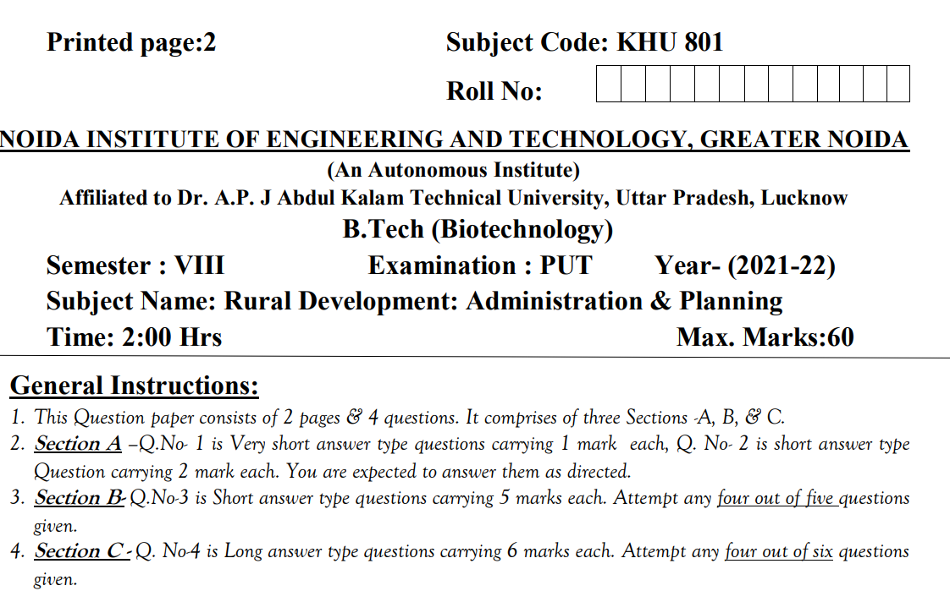
Sessional Question paper (PUT)

Slide 104
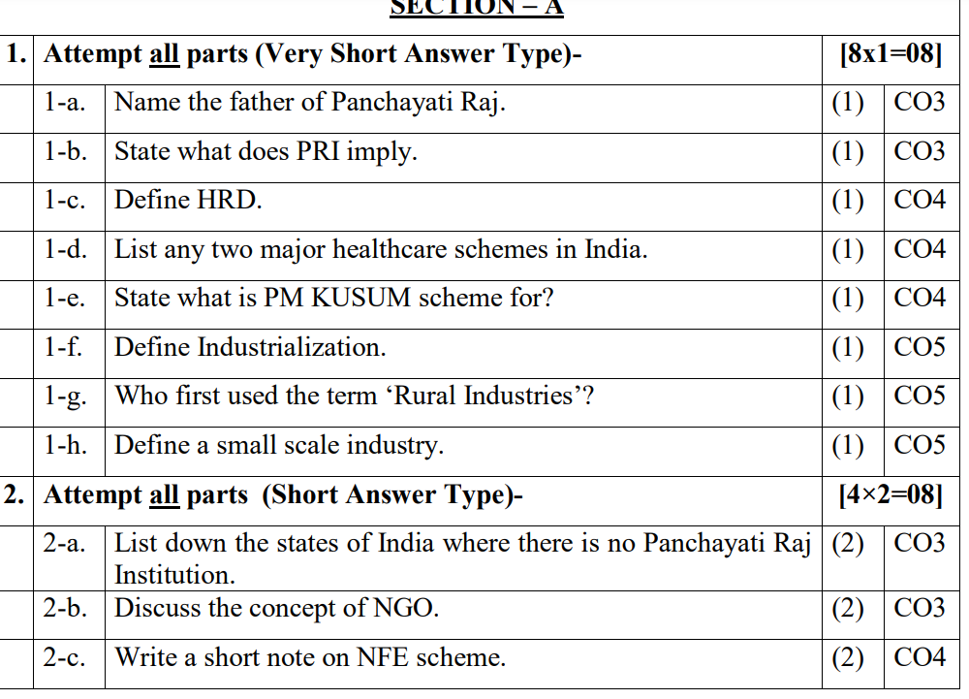
Sessional Question paper (PUT)

Slide 105
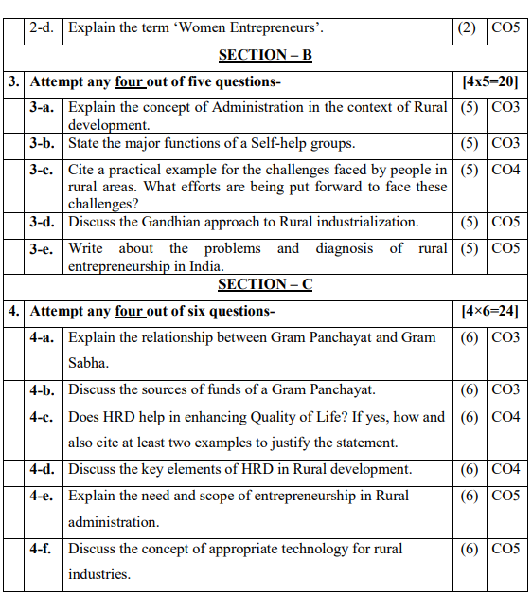
Sessional Question paper (PUT)

Slide 106
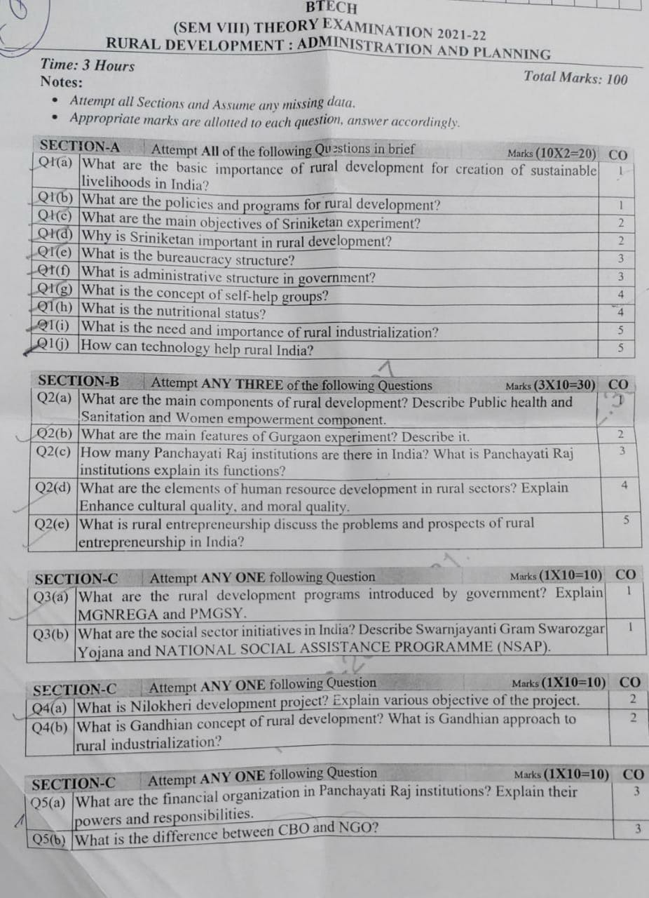
End Semester Question paper

Slide 107
End Semester Question paper

Slide 108
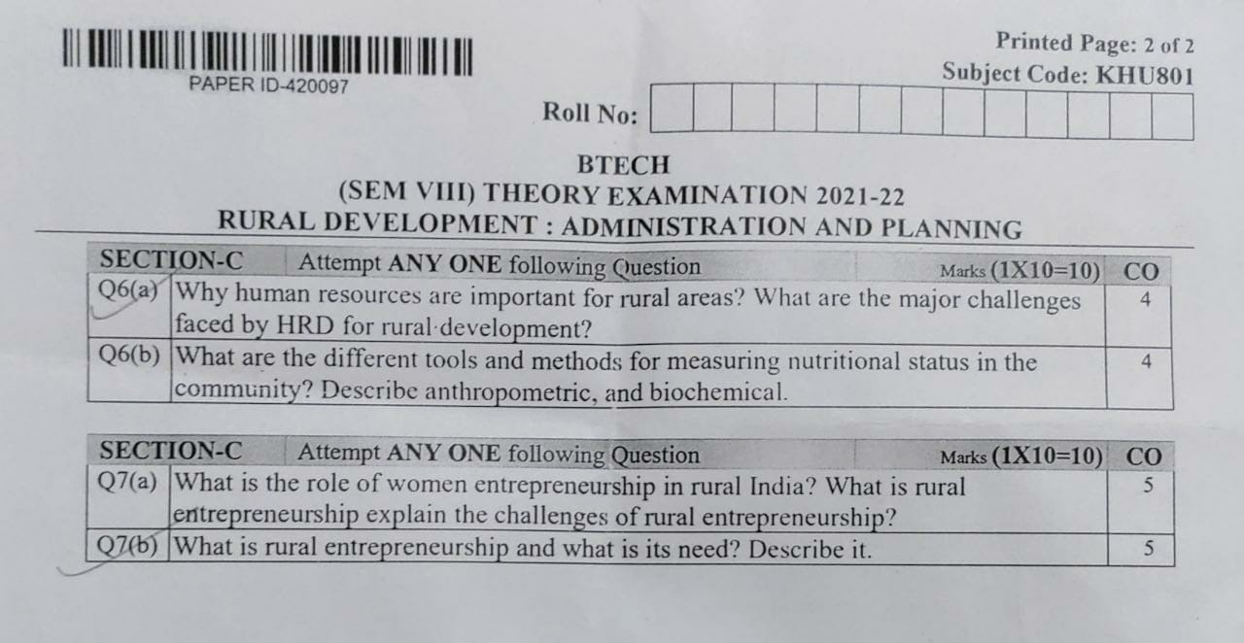
End Semester Question paper

Slide 109
Expected questions for University Exams
Define rural development.
Name the key initiatives required for agricultural development in rural areas.
Discuss what has happened to the agriculture output during 2007-12?
Explain micro-credit programme
Define sustainable livelihood.
Explain why is rural development important.
Discuss the changes that have taken place in Indian agriculture and rural sector since initiation of reforms.
Discuss the essential elements of rural development?
Discuss salient features of Mahatma Gandhi National Employment Scheme.
Write a detailed note on the different schemes for social security in India.

Slide 110

Summary
List of Social Security Schemes in India 2022
PM-KISAN (Pradhan Mantri Kisan Samman Nidhi) Scheme
Pradhan Mantri Kisan Maan Dhan Yojana
PM Garib Kalyan Yojana (PMGKY)
Pradhan Mantri Shram Yogi Maan-Dhan
Skill India Mission
Make in India
Swachh Bharat Mission
Sukanya Samriddhi Scheme – Beti Bachao Beti Padhao
PM Mudra Yojna
Ujala Yojna
Atal Pension Yojana
Prime Minister Jeevan Jyoti Bima Yojana
Simran Kaur KHU701_RD Unit 1
Notes:
https://krishijagran.com/agripedia/important-government-schemes-programmes-in-agriculture/

Slide 111
References
Katar Singh: Rural Development in India – Theory History and Policy
Arora R.C – Integrated Rural Development in India
Dhandekar V.M and Rath N poverty in India
A.N.Agarwal and KundanaLal: Rural Economy of India
B.K.Prasad: Rural Development-Sarup& Son’s Publications.

